Slide 1
RAJASTHAN IT DAY
2018
GREEN-A-THON

Slide 2
TOPIC:
RECYCLING STYROFOAM/ POLYSTYRENE PRESENT IN THE PLASTIC, TO OBTAIN USEFUL PRODUCTS LIKE ACTIVATED CARBON BY USE OF STYRO-FILTER AND STYRO-DECOMPOSER

Slide 3
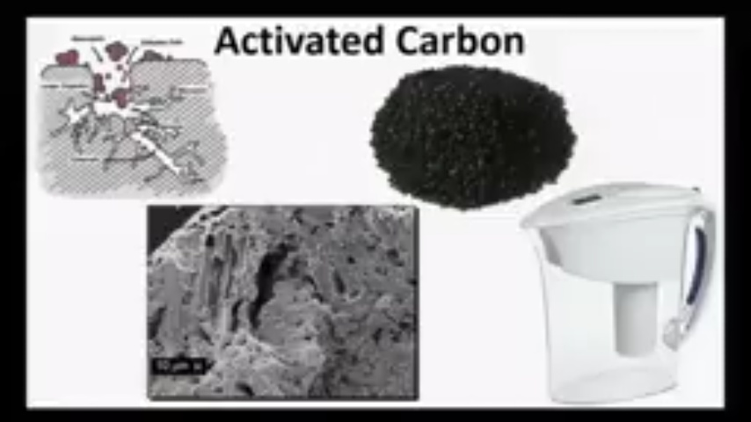

Slide 4
PROBLEM:
Plastic has been always considered as the biggest threat to environment as it endangers the life of animals if ingested.
Plastic constitute a larger area of our day to day life, but cannot be degraded that gives a hazardous effect on the environment.
It causes soil pollution and if tried to destroy by burning then create a marked air pollution
So, recycling this plastic is a need of hour, that’s what we are doing with our project.

Slide 5
AFFECTED COMMUNITY:
Each and every community on earth is affected by plastic badly.
It is affecting humans, animals, environment as well as harmful to agriculture and horticulture fields.

Slide 6
TIME OF WORKING ON THIS PROJECT:
We were thinking of this project since the time govt. banned the plastic bags because in my opinion not using something is not the solution of a problem, but as we came to know about the green-a – thon we found it as an opportunity to show off our skills, so, here we are with our dream project.

Slide 7
TECHNOLOGY OR PROCESS?
We are using two basic technologies
1. biotechnology
2. microbiology

Slide 8
INTRODUCTION TO STYROFOAM:
A Styrofoam is a expanded form of polystyrene, which is a main constituent of each and every plastic
In India approximately 2 tons of plastic are placed in the dump yard every year which is dangerous to the enviorment.
This polystyrene is always considered as non recyclable . So our business plan mainly focuses on recycling this non bio degredable polystyrene into degredable plastics and getting useful products from it.

Slide 9
METHODS:
STYRO-FILTER:
In this technology we are using different technique like densification, pyrolysis and chemical treatment to get the activated carbon from this dump of waste.
STYRO- DECOMPOSER:
This technique is baased on the microbiology. In this I m using a strain of bacteria ideonella sakienesis and mealworms to decompose the plastic and converting it into softer biodegredable plastic which can also be used to form new softer plastic products like plastic cups, thermacoals and the feaces produced by the mealworms can be used as biomass or fertilisers.

Slide 10
KEY ACTIVITIES
STEP 1: Collection and seggregation of waste
STEP2: Transfer to our plant
STEP3:Pieces are transferred to both the units
Step4: At filter unit the piecees of styrofoam are filled in densification unit then this mass is sent to pyrolysis unit then to chemical unit then the final product is collected.
STEP5: Final product sent to potential market for sale.
Step6: Styrofoam pieces are transfferd to decomposer unit and digested using bacterial species and mealworms
STEP7: The soften plastic is then moulded to produce new plastic products.

Slide 11
STYRO- FILTER:
1. Approx 50 kg of styrofoam is taken and transferd to densification assembly maintained at 100 degree where is get compacted and densified to a compact mass.
2.Then this mass is sent to pyrolysis assembly this unit works at a temp of 300 degree celsius with nitrogen.
3. Then it is collected and placed in the chemical treatment assembly where it comes in contact with the phosphoric acid at a temp of 500 degree.
4. Now at last we obtain our desired product, activated carbon this can then be used to purify water.

Slide 12
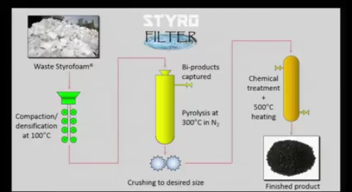
DIAGRAMMETIC REPRESENTATION

Slide 13
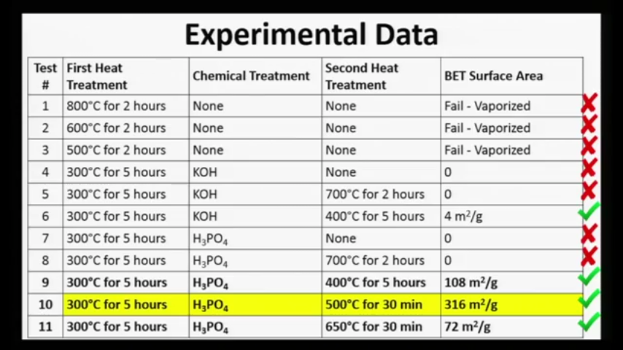

Slide 14
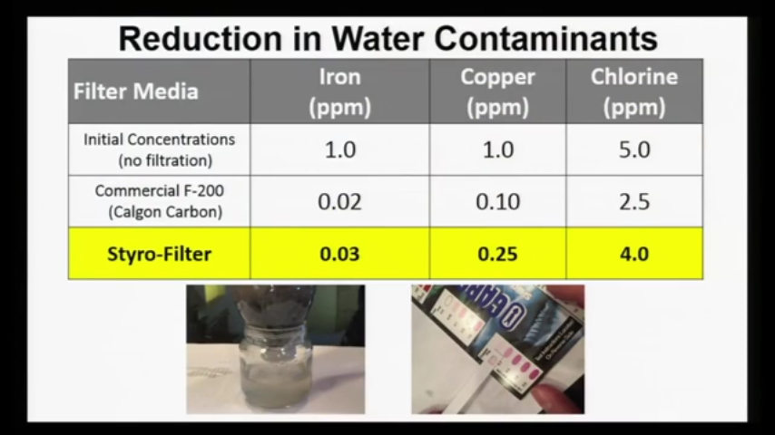

Slide 15
STYRO-DECOMPOSER:
It uses a strain of bacteria, ideonella sakienesis and mealworms to digest an enzyme PET present in the plastic.
Amt. of styrofoam is transferred to decomposer assembly with strains of bacteria and mealworm.
They decompose the PET for 1-2 months after that we get a newer and bio degredable form of plastic which also be reused now and the feaces produced by the mealworm are rich in biomass and can be used as fertilisers.

Slide 16
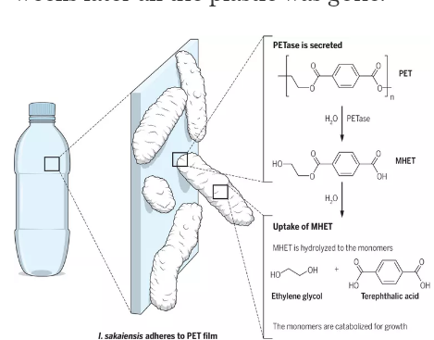

Slide 17
CHALLENGES:
Getting the strains of bacteria ideonella sakieneasis and mealworm is the challenge.
When we will heat styrofoam in styrofilter assembly there will be a lot of air pollution controlling that pollution is the biggest challenge for that we will use smoke absorbers.

Slide 18
Revenue streams:
My potential market includes:
1. filter or purification industries as carbon acts as a water purifier.
2. pharmaceutical industries as activated carbon is an major antidote for many poisoning.
3. plastic manufacturing industries as form of plastic I m making can b used for manufacturing new plastic products.

Slide 19
MARKET COMPETITORS
There is no competitor for my project in indian market because this concept is new to indian market.

Slide 20
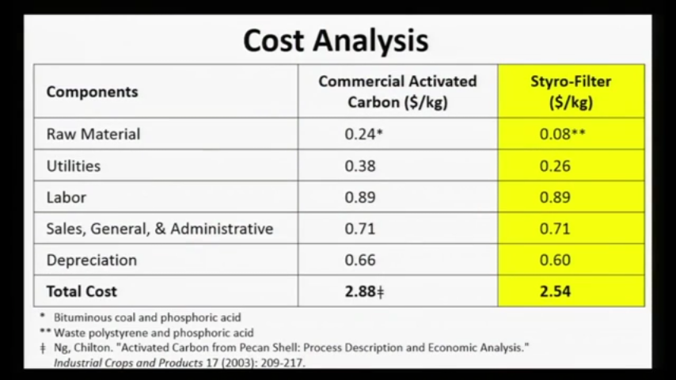
COST STRUCTURE:

Slide 21
S.W.O.T. ANALYSIS:
Our biggest strengths include our hardwork and dedication towards the project. our project is one solution for two problems.
Weakness of my project include un experience in this field.
Opportunity includes a most advantage as it will provide employment to a major community.It will provide major pollution control and as it is new to indian market it is an ideal business.
Threats to business includes difficulty in getting bacterial srtrains.

Slide 22
PROBABLE OUTCOMES AND FUTURE ASPECTS.
A POLLUTION FREE SOCIETY
GETTING PURIFIED WATER BY USE OF ACTIVATED CARBON.
CONTROL OF POLLUTION
ENVIRONMENT SAFETY.
CONVERTING THE WASTE INTO PROFITABLE PRODUCT.

Slide 23
KEY PARTNERS:
1. HUMAN RESOURCE
MAN POWER TO COLLECT THE WASTE FROM BEACHES, ROADS, HOUSES AND COLONIES.
MAN POWER TO SEPRATE AND SEGGREGATE WASTE TO GET OUR DESIRED WASTE.
MAN POWER TO HANDLE THE MACHINARY.
MAN POWER TO TRANSPORT THE MATERIALS.
2. FINANCIAL PARTNERS
PARENTS
FRIENDS
RELATIVES
3. MATERIAL MANAGEMENT
GETTING THE SPECIES OF BACTERIA AND MEALWORM.
MACHINARY FOR THE PLANT

Slide 24
VALUE PROPOSITION:
My plant is unique in its kind. It does not have any competitor. I want to serve the industry with fair products without any spurious claims.

Slide 25
CUSTOMER RELATIONSHIPS:
Fair to each and every customer.
Good relation with every competitor in market.
Good relation with the employees.
Not indulging in any type of mischief.

Slide 26
THANK YOU
TEAM NAME: GREEN ROBOTS
TEAM LEAD: BHARAT DADHICH
TEAM MAMBERS: SIDDHARTH KUMAR
HARISH

